Slide 1

AIRPORT management SYSTEM DATABASE

Slide 2

PROJECT OVERVIEW
Airport facilities rely on a number of systems IN ORDER TO PEERFORM SOME SPECIFIC PROCESSES and I am creating a database as a combination of airlines and airport in which, not only our focus will be on the airline system but primarily my focus will be to create a database for the airport system as well. As Airport system is a database project that primarily deals with the management of the airport, airlines, passengers and employees working for an airport.

Slide 3
PROJECT DESCIPTION
MY PROJECT HAS 4 MAIN MODULES AND IS FURTHER PROCEEDED WITH ITS ENTITIES.
AIRPORT -> CITY, AIRPORT, AIRLINES, AIRPORTCONTAINSAIRLINES , FLIGHT
EMPLOYEE -> EMPLOYEEDETAILS, EMPLOYEESALARY
PASSANGER -> PASSENGERDETAILS, PASSENGER , PASSENGERFLIGHT
TICKET -> TICKETDETAILS , TICKETBOOK , TICKETCANCEL

Slide 4
ENTITIES BEFORE NORMALISATION
CITY
CityName | STATE | COUNTRY
AIRPORT
AirportName | STATE | COUNTRY
AIRLINE
AirlineID | AirlineName | ThreeDigitCode
FLIGHT
FlightCode | SOURCE | DESTINATION | ARRIVAL | DEPARTURE | STATUS | DURATION | FlightType | LayoverTime | NoOfStops
PASSANGER
PassangerID | PassportNumber | FName | MName | LName | ADDRESS | PHONE | AGE | SEX
TICKET
TicketNumber | SOURCE | DESTINATION | DateOfTravel | SeatNumber | CLASS | PRICE
EMPLOYEE
SSN | FName | MName | LName | ADDRESS | PHONE | AGE | SEX | JOBTYPE | SALARY

Slide 5
ER diagram contains following relationships
Entity 1 | Name of Relationship | Entity 2 | Cardinality
City | has | Airport | 1:1
Airport | contains | Airline | m:n
Airport | has | Employee | 1 : n
Airline | has | Flight | 1 : n
Flight | carries | Passengers | 1 : n
Employee | serves | Passengers | m : n
Passenger | books | Ticket | 1 : n
Passenger | cancels | Ticket | 1 : n
Type of the binary relationship | Relationships in the system
one-to-one relationship | City has only one airport.
one-to-many relationship | An airline has multiple flights, that is many flights belong to the same airline company. A flight carries many passengers. A passenger can book one or more tickets. A passenger can cancel one or more tickets.
many-to-many relationship | All International airlines operating through various countries across the world have their offices located in all major cities and airports they cover. Hence, an airport may have many airline offices.

Slide 6
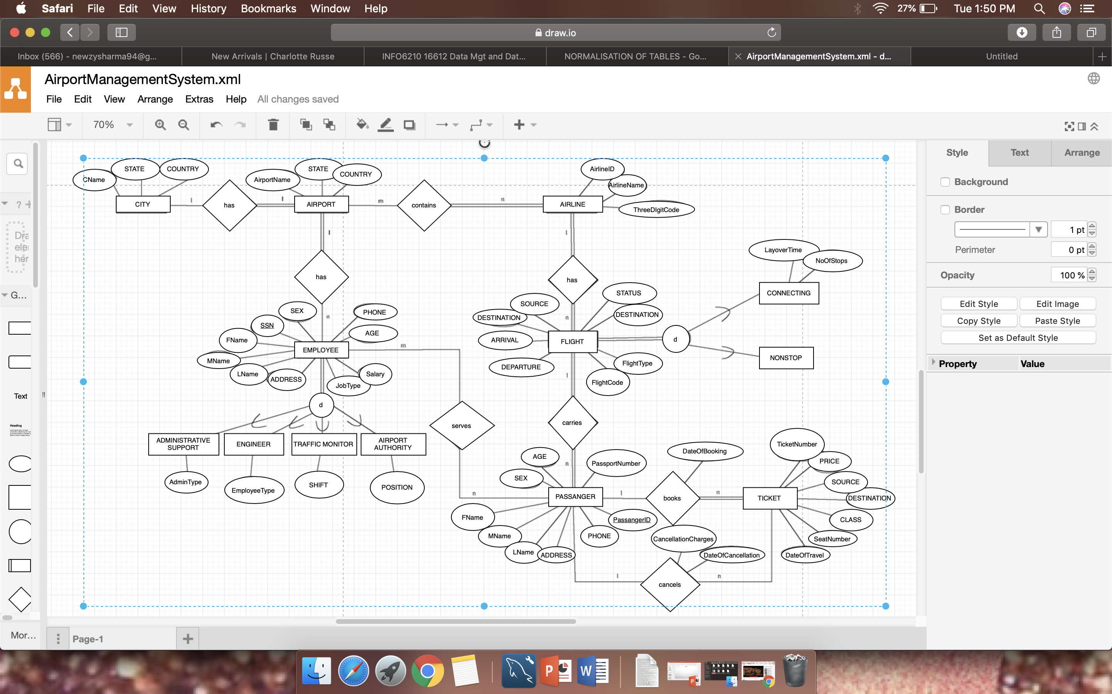
ER DIAGRAM

Slide 7

NORMALIZATION OF TABLES
Database normalization is the process of restructuring a relational database in accordance with a series of normal forms in order to reduce data redundancy and improve data integrity. It was first proposed by Edgar F. Codd as an integral part of his relational model.

Slide 8
FUNCTIONAL DEPENDECIES
PassportNumber -> FName, MName, LName, ADDRESS, PHONE, AGE, SEX | Violates 2NF
PassangerID ->FlightCode | Violates 2NF
DateOfBooking, SOURCE, DESTINATION, CLASS -> PRICE | Violates 3NF
DateOfCancellation -> CancellationCharges | Violates 3NF
JobType -> SALARY | Violates 3NF

Slide 9
TABLES AFTER NORMALISATION
CITY (CityName, STATE, COUNTRY) AIRPORT (AirportName, STATE, COUNTRY, CNAME) AIRLINE (AirlineID, AirlineName, ThreeDigitCode) AIRPORTCONTAINSAIRLINES (AirlineID, AirportName) FLIGHT (FlightCode, SOURCE, DESTINATION, ARRIVAL, DEPARTURE, STATUS, DURATION, FlightType, LayoverTime,NoOfStops, AIRLINEID) PASSENGER (PassangerID, PassportNumber) PASSENGERDETAILS(PASSPORTNO, FNAME, M, LNAME, ADDRESS, PHONE, AGE, SEX) PASSENGERFLIGHT (PassangerID, FLlightCode) TICKETDETAILS (TicketNumber, SOURCE, DESTINATION,DateOfBooking,DateOfTravel,SeatNumber, CLASS,DateOfCancellation, PassangerID, PassportNumber) TICKETBOOK (DateOfBooking, SOURCE, DESTINATION, CLASS, PRICE) TICKETCANCEL(DateOfCancellation, CancellationCharges) EMPLOYEEDETAILS (SSN, FName, MName, LName, ADDRESS, PHONE, AGE, SEX, JobType, AdminType, EmployeeType, AirportName) EMPLOYEESALARY(JobType, SALARY) EMPLOYEESERVESPASSANGER (SSN, PassangerID, PassportNumber)

Slide 10
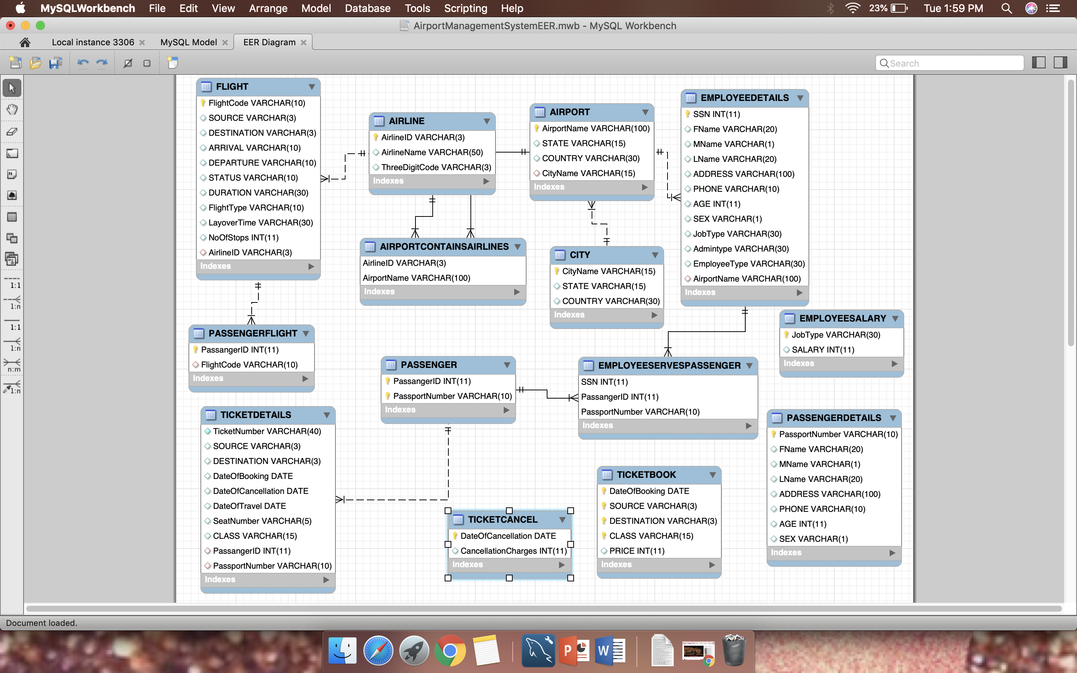
EER DIAGRAM

Slide 11
SQL QUERIES
CREATE TABLE CITY
(
CityName VARCHAR(15) NOT NULL,
STATE VARCHAR(15),
COUNTRY VARCHAR(30),
PRIMARY KEY(CityName)
);
('Mumbai','Maharashtra','India'),
('Louisville','Kentucky','United States'),
('Boston','Massasuchetts','United States'),
('Fort Worth','Texas','United States'),
('San Francisco', 'California', 'United States'),
('Frankfurt','Hesse','Germany'),
('Houston','Texas','United States'),
('New York City','New York','United States'),
('Tampa', 'Florida', 'United States');
('Delhi','Delhi','India'),
('Chandigarh','Chandigarh','India'),
VALUES
INSERT INTO CITY

Slide 12
CREATE TABLE AIRPORT(
AirportName VARCHAR(100) NOT NULL,
STATE VARCHAR(15),
COUNTRY VARCHAR(30),
CityName VARCHAR(15),
PRIMARY KEY(AirportName),
FOREIGN KEY(CityName) REFERENCES CITY(CityName)
ON DELETE CASCADE);
INSERT INTO AIRPORT
VALUES
('Chandigarh International Airport','Chandigarh','India','Chandigarh'),
('Indira GandhiInternational Airport','Delhi','India','Delhi'),
('Chhatrapati Shivaji International Airport','Maharashtra','India','Mumbai'),
('Louisville International Airport','Kentucky','United States','Louisville'),
('Logan International Airport' ,'Massasuchetts','United States','Boston'),
('Dallas/Fort Worth International Airport','Texas','United States','Fort Worth'),
('San Francisco International Airport','California', 'United States','San Francisco'),
('Frankfurt Airport','Hesse','Germany','Frankfurt'),
('George Bush Intercontinental Airport','Texas','United States','Houston'),
('John F. Kennedy International Airport','New York','United States','New York City'),
('Tampa International Airport','Florida', 'United States','Tampa');

Slide 13
CREATE TABLE AIRLINE ( AirlineID VARCHAR(3) NOT NULL, AirlineName VARCHAR(50), ThreeDigitCode VARCHAR(3), PRIMARY KEY(AirlineID) ); INSERT INTO AIRLINE VALUES ('AA','American Airlines','001'), ('AI','Air India Limited','098'), ('LH','Lufthansa', '209'), ('BA','British Airways','125'), ('QR','Qatar Airways','157'), ('9W','Jet Airways','222'), ('EK','Emirates','176'), ('EY','Ethiad Airways','607');

Slide 14
CREATE TABLE AIRPORTCONTAINSAIRLINES
(AirlineID VARCHAR(3) NOT NULL,
AirportName VARCHAR(100) NOT NULL,
PRIMARY KEY(AirlineID, AirportName),
FOREIGN KEY(AirlineID) REFERENCES AIRLINE(AirlineID)
ON DELETE CASCADE,
FOREIGN KEY(AirportName) REFERENCES AIRPORT(AirportName)
ON DELETE CASCADE);
INSERT INTO AIRPORTCONTAINSAIRLINES
VALUES
('AA','Louisville International Airport'),
('AA','John F. Kennedy International Airport'),
('AA','George Bush Intercontinental Airport'),
('AA','San Francisco International Airport'),
('AA','Tampa International Airport'),
('AI','Chandigarh International Airport'),
('AI','Dallas/Fort Worth International Airport'),
('AI','Indira GandhiInternational Airport'),
('AI','Chhatrapati Shivaji International Airport'),
('AI','George Bush Intercontinental Airport'),
('LH','Chhatrapati Shivaji International Airport'),
('LH','Frankfurt Airport'),
('LH','John F. Kennedy International Airport'),
('LH','San Francisco International Airport'),
('LH','Dallas/Fort Worth International Airport'),
('BA','John F. Kennedy International Airport'),
('BA','Chhatrapati Shivaji International Airport'),
('BA','Chandigarh International Airport'),
('BA','Frankfurt Airport'),
('BA','San Francisco International Airport'),
('QR','Chhatrapati Shivaji International Airport'),
('QR','Dallas/Fort Worth International Airport'),
('QR','John F. Kennedy International Airport'),
('QR','Tampa International Airport'),
('QR','Louisville International Airport');

Slide 15
CREATE TABLE FLIGHT(
FlightCode VARCHAR(10) NOT NULL,
SOURCE VARCHAR(3),
DESTINATION VARCHAR(3),
ARRIVAL VARCHAR(10),
DEPARTURE VARCHAR(10),
STATUS VARCHAR(10),
DURATION VARCHAR(30),
FlightType VARCHAR(10),
LayoverTime VARCHAR(30),
NoOfStops INT,
AirlineID VARCHAR(3),
PRIMARY KEY(FlightCode),
FOREIGN KEY(AirlineID) REFERENCES AIRLINE(AirlineID)
ON DELETE CASCADE);
INSERT INTO FLIGHT
VALUES
('AI2014', 'BOM', 'DFW', '02:10', '03:15', 'On-time', '24hr', 'Connecting', 3, 1, 'AI'),
('QR2305', 'BOM', 'DFW', '13:00', '13:55', 'Delayed', '21hr', 'Non-stop', 0, 0, 'QR'),
('EY1234', 'JFK', 'TPA', '19:20', '20:05',' On-time',' 16hrs', 'Connecting', 5, 2, 'EY'),
('LH9876', 'JFK', 'BOM',' 05:50', '06:35', 'On-time', '18hrs', 'Non-stop', 0, 0, 'LH'),
('BA1689', 'FRA', 'DEL', '10:20', '10:55', 'On-time', '14hrs', 'Non-stop', 0, 0, 'BA'),
('AA4367', 'SFO', 'FRA', '18:10', '18:55', 'On-time', '21hrs', 'Non-stop' ,0 , 0, 'AA'),
('QR1902', 'IXC', 'IAH', '22:00' ,'22:50', 'Delayed',' 28hrs', 'Non-stop', 5, 1, 'QR'),
('BA3056', 'BOM', 'DFW', '02:15', '02:55', 'On-time', '29hrs', 'Connecting' ,3, 1, 'BA'),
('EK3456', 'BOM', 'SFO', '18:50', '19:40', 'On-time', '30hrs', 'Non-stop', 0, 0, 'EK'),
('9W2334','IAH','DEL','23:00','13:45','On-time','23hrs','Direct',0,0,'9W');

Slide 16
CREATE TABLE EMPLOYEEDETAILS
(
SSN INT NOT NULL,
FName VARCHAR(20),
MName VARCHAR(1),
LName VARCHAR(20),
ADDRESS VARCHAR(100),
PHONE VARCHAR(10),
AGE INT,
SEX VARCHAR(1),
JobType VARCHAR(30),
Admintype VARCHAR(30),
EmployeeType VARCHAR(30),
AirportName VARCHAR(100),
PRIMARY KEY(SSN),
FOREIGN KEY(AirportName) REFERENCES AIRPORT(AirportName)
ON DELETE CASCADE
);
INSERT INTO EMPLOYEEDETAILS
VALUES
(123456789,'NEWZY','N','SHARMA','731 Fondren, Houston, TX',8578914638, 35, 'F','ADMINISTRATIVE SUPPORT', 'RECEPTIONIST','','Louisville International Airport'),
(333445555,'BHAGI','R','KUNDU','638 Voss, Houston, TX',8578914639, 40, 'F','ADMINISTRATIVE SUPPORT', 'SECRETARY','','Louisville International Airport'),
(999887777,'NEWZY','N','SHARMA','3321 Castle, Spring, TX',9834666995, 50, 'F','ENGINEER','','RADIO ENGINEER','Louisville International Airport'),
(987654321,'SHERLOCK','A','HOLMES','123 TOP HILL, SAN Francisco,CA',8089654321, 47, 'M','TRAFFIC MONITOR','','','San Francisco International Airport'),
(666884444,'SHELDON','A','COOPER','345 CHERRY PARK, HESSE,GERMANY',1254678903, 55, 'M','TRAFFIC MONITOR','','NIGHT','Frankfurt Airport'),
(453453453,'ROBIN','B','JOSHI','345 FLOYDS, MUMBAI,INDIA',4326789031, 35, 'M','AIRPORT AUTHORITY','','','Chhatrapati Shivaji International Airport'),
(987987987,'BHAVN','B','SHARMA','110 SYNERGY PARK, DALLAS,TX',5678904325, 33, 'M','ENGINEER','','AIRPORT CIVIL ENGINEER','Dallas/Fort Worth International Airport'),
(888665555,'SHUBHAM','R','GUPTA','567 CHANDANI CHOWK, DELHI, INDIA',8566778890, 39, 'M','ADMINISTRATIVE SUPPORT','DATA ENTRY WORKER','','Indira GandhiInternational Airport'),
(125478909,'PRATIK','T','GOMES','334 VITRUVIAN PARK, ALBANY, NY',4444678903, 56, 'M','TRAFFIC MONITOR','','DAY','John F. Kennedy International Airport'),
(324567897,'VIKAS','R','SINGH','987 SOMNATH, CHANDIGARH, INDIA',2244658909, 36, 'M','TRAFFIC MONITOR','','DAY','Chandigarh International Airport');

Slide 17
CREATE TABLE EMPLOYEESALARY
(
JobType VARCHAR(30) NOT NULL,
SALARY INT,
PRIMARY KEY(JobType)
);
INSERT INTO EMPLOYEESALARY
VALUES
('ADMINISTRATIVE SUPPORT',50000),
('ENGINEER',70000),
('TRAFFIC MONITOR',80000),
('AIRPORT AUTHORITY',90000);

Slide 18
CREATE TABLE EMPLOYEESERVESPASSENGER
(SSN INT NOT NULL,
PassangerID INT NOT NULL,
PassportNumber VARCHAR(10) NOT NULL,
PRIMARY KEY(SSN, PassangerID, PassportNumber),
FOREIGN KEY(PassangerID, PassportNumber) REFERENCES PASSENGER(PassangerID, PassportNumber) ON DELETE CASCADE);
ALTER TABLE EMPLOYEESERVESPASSENGER
ADD FOREIGN KEY(SSN) REFERENCES EMPLOYEEDETAILS(SSN);

Slide 19
CREATE TABLE PASSENGERDETAILS
(
PassportNumber VARCHAR(10) NOT NULL,
FName VARCHAR(20),
MName VARCHAR(1),
LName VARCHAR(20),
ADDRESS VARCHAR(100),
PHONE VARCHAR(10),
AGE INT,
SEX VARCHAR(1),
PRIMARY KEY(PassportNumber)
);
INSERT INTO PASSENGERDETAILS
VALUES
('A1234568','SHELLY','M','MADAN','2230 NORTHSIDE, APT 11, ALBANY, NY',8080367290,30,'F'),
('B9876541','RISHAV','V','SHARMA','3456 VIKAS APTS, APT 102,DOMBIVLI, INDIA',8080367280,26,'M'),
('C2345698','DEEPIKA','A','SINGH','7820 MCCALLUM COURTS, APT 234, AKRON, OH',8082267280,30,'F'),
('D1002004','NEETU','S','SAGAR','7720 MCCALLUM BLVD, APT 1082, DALLAS, TX',9080367266,23,'F'),
('X9324666','NEHA','B','GOYAL','9082 ESTAES OF RICHARDSON, RICHARDSON, TX',9004360125,28,'F'),
('B8765430','PARUL','P','MANOCHA','1110 FIR HILLS, APT 903, AKRON, OH',7666190505,30,'F'),
('J9801235','KUSHAL','D','MADAN','345 CHATHAM COURTS, APT 678, MUMBAI, INDIA',9080369290,29,'M'),
('A1122334','RINKAL','S','AGGARWAL','5589 CHTHAM REFLECTIONS, APT 349 HOUSTON, TX',9004335126,25,'F'),
('Q1243567','RANVEER','M','SINGH','4444 FRANKFORD VILLA, APT 77, GUILDERLAND, NY',9727626643,22,'M'),
('S1243269','HRITHIK','A','ROSHAN','7720 MCCALLUM BLVD, APT 2087, DALLAS, TX',9004568903,60,'M'),
('E3277889','SHAHID','A','KAPOOR','1234 BAKER APTS, APT 59, HESSE, GERMANY',9724569986,10,'M'),
('K3212322','ANUSHKA','B','SHARMA','6785 SPLITSVILLA, APT 34, MIAMI, FL',9024569226,15,'F'),
('P3452390','ANISHA','V','PAUDOKNE','548 MARKET PLACE, SAN Francisco, CA',9734567800,10,'F'),
('W7543336','JOHN','P','SMITH','6666 ROCK HILL, APT 2902, TAMPA, FL',4624569986,55,'M'),
('R8990566','VIVEK','T','SHARMA','3355 PALENCIA, APT 2065, MUMBAI, INDIA',4724512343,10,'M');

Slide 20
CREATE TABLE PASSENGER(
PassangerID INT NOT NULL,
PassportNumber VARCHAR(10) NOT NULL,
PRIMARY KEY(PassangerID, PassportNumber));
INSERT INTO PASSENGER
VALUES
(1,'A1234568'),
(2,'B9876541'),
(3,'C2345698'),
(4,'D1002004'),
(5,'X9324666'),
(6,'B8765430'),
(7,'J9801235'),
(8,'A1122334'),
(9,'Q1243567'),
(10,'S1243269'),
(11,'E3277889'),
(12,'K3212322'),
(13,'P3452390'),
(14,'W7543336'),
(15,'R8990566');

Slide 21
CREATE TABLE PASSENGERFLIGHT(
PassangerID INT NOT NULL,
FlightCode VARCHAR(10),
PRIMARY KEY(PassangerID),
FOREIGN KEY(FlightCode) REFERENCES FLIGHT(FlightCode)
ON DELETE CASCADE);
INSERT INTO PASSENGERFLIGHT
VALUES
(1,'AI2014'),
(2,'LH9876'),
(3,'9W2334'),
(4,'QR1902'),
(5,'EY1234'),
(6,'BA3056'),
(7,'9W2334'),
(8,'AA4367'),
(9,'QR1902'),
(10,'EK3456'),
(11,'BA1689'),
(12,'QR1902'),
(13,'AI2014'),
(14,'BA1689'),
(15,'QR2305');

Slide 22
CREATE TABLE TICKETDETAILS
(
TicketNumber VARCHAR(40) NOT NULL,
SOURCE VARCHAR(3),
DESTINATION VARCHAR(3),
DateOfBooking DATE,
DateOfCancellation DATE,
DateOfTravel DATE,
SeatNumber VARCHAR(5),
CLASS VARCHAR(15),
PassangerID INT,
PassportNumber VARCHAR(10),
FOREIGN KEY(PassangerID, PassportNumber) REFERENCES PASSENGER(PassangerID, PassportNumber)
ON DELETE CASCADE
);
INSERT INTO TICKETDETAILS
VALUES
(0011234111122,'BOM','DFW','2018-05-11',null,'2018-12-15','32A','ECONOMY',1,'A1234568'),
(0984567222299,'JFK','BOM','2018-06-11','2018-07-04','2018-07-14','45D','ECONOMY',2,'B9876541'),
(1768901333273,'IAH','DEL','2018-08-16',null,'2018-12-25','1A','BUSINESS',3,'C2345698'),
(5890987441464,'IXC','IAH','2018-08-17',null,'2018-12-12','20C','FIRST-CLASS',4,'D1002004'),
(1577654664266,'JFK','TPA','2018-06-16',null,'2018-07-16','54E','ECONOMY',5,'X9324666'),
(2206543545545,'BOM','DFW','2018-11-16',null,'2018-12-20','43B','ECONOMY',6,'B8765430'),
(7064321779737,'IAH','DEL','2018-11-18',null,'2018-12-16','27B','FIRST-CLASS',7,'J9801235'),
(1571357215116,'SFO','FRA','2018-10-16',null,'2018-11-16','34E','ECONOMY',8,'A1122334'),
(1570864987655,'IXC','IAH','2018-11-16',null,'2018-11-26','54C','ECONOMY',9,'Q1243567'),
(1579283997799,'BOM','SFO','2018-01-02',null,'2018-02-02','38A','ECONOMY',10,'S1243269'),
(1255701876107,'FRA','DEL','2018-01-01',null,'2018-01-06','57F','ECONOMY',11,'E3277889'),
(1251334499699,'IXC','IAH','2018-11-02',null,'2018-11-27','45D','ECONOMY',12,'K3212322'),
(1258776199490,'BOM','DFW','2018-09-20','2018-12-14','2018-12-24','37C','ECONOMY',13,'P3452390'),
(5891155114477,'FRA','DEL','2018-01-06',null,'2018-01-18','55C','ECONOMY',14,'W7543336'),
(5893069766787,'BOM','DFW','2018-08-15',null,'2018-08-30','33F','ECONOMY',15,'R8990566');

Slide 23
CREATE TABLE TICKETBOOK
(
DateOfBooking DATE NOT NULL,
SOURCE VARCHAR(3) NOT NULL,
DESTINATION VARCHAR(3) NOT NULL,
CLASS VARCHAR(15) NOT NULL,
PRICE INT,
PRIMARY KEY(DateOfBooking, SOURCE, DESTINATION, CLASS)
);
INSERT INTO TICKETBOOK
VALUES
('2018-05-11','BOM','DFW','ECONOMY',95000),
('2018-06-11','JFK','BOM','ECONOMY',100000),
('2018-08-16','IAH','DEL','BUSINESS',200000),
('2018-08-17','IXC','IAH','FIRST-CLASS',150000),
('2018-06-16','JFK','TPA','ECONOMY',98000),
('2018-11-16','BOM','DFW','ECONOMY',125000),
('2018-11-18','IAH','DEL','FIRST-CLASS',195000),
('2018-10-16','SFO','FRA','ECONOMY',170000),
('2018-11-16','IXC','IAH','ECONOMY',140000),
('2018-01-02','BOM','SFO','ECONOMY',45000),
('2018-01-01','FRA','DEL','ECONOMY',100000),
('2018-11-02','IXC','IAH','ECONOMY',120000),
('2018-09-20','BOM','DFW','ECONOMY',65000),
('2018-01-06','FRA','DEL','ECONOMY',80000),
('2018-08-15','BOM','DFW','ECONOMY',98000);

Slide 24
CREATE TABLE TICKETCANCEL
(
DateOfCancellation DATE NOT NULL,
CancellationCharges INT,
PRIMARY KEY(DateOfCancellation)
);
INSERT INTO TICKETCANCEL
VALUES
('2018-04-4',75000),
('2018-05-17',25000);

